Slide 1
Burger’s Equation and PINNs Iragavarapu Ramanaa Sreehaas cb.ai.u4aid24068

Slide 2
AGENDA
Introduction
The problem
The solution
The implementation
Results

Slide 3
Burger’s equation is a function that defines the relation between the viscous force and diffusion of a gas or any fluidic substance over a given distance and time. It is a core concept in physics laws and a simple example to demonstrate the necessity and efficiency of a PINN.

Slide 4
The problems with solving traditionally -> methods like FDM and FEM approximate the terms they cannot calculate which leads to a loss in the accuracy -> They suffer from curse of dimensionality which causes them to exponentially significantly get slower as the dimensions of the equation increases

Slide 5
The solution to this problem is to develop a physics informed neural network
-> A PINN is a neural network that predicts relevant points which abide physics equations or ‘laws’ and can be used to generation accurate physics simulations.
-> It does not suffer a heavy tax from the curse of dimensionality and produces accurate results without any term approximation.
-> It could also be used to solve the inverse problem for burger’s equation or any equation for that matter with ease and efficiency.

Slide 6
The implementation: -> define field variables -> define physics laws -> incorporate boundary and initial conditions -> choose appropriate normalization and loss functions -> run the program

Slide 7
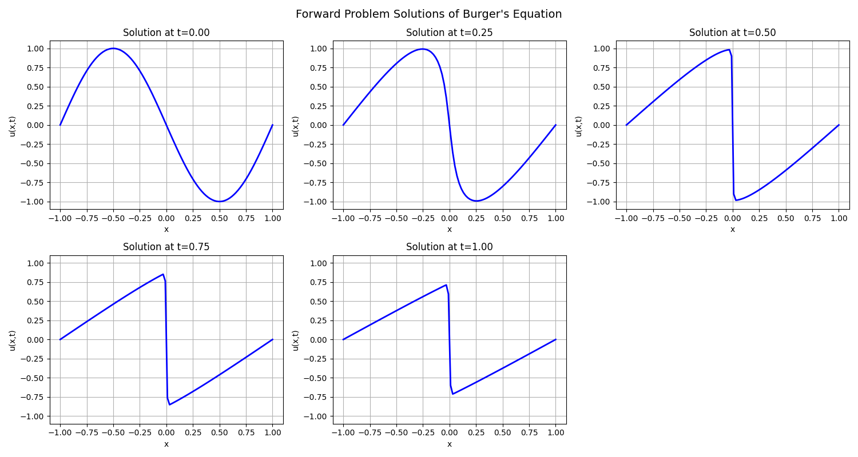
Outputs from the forward problem program for burger’s equation (perfectly accurate with FDM method)

Slide 8
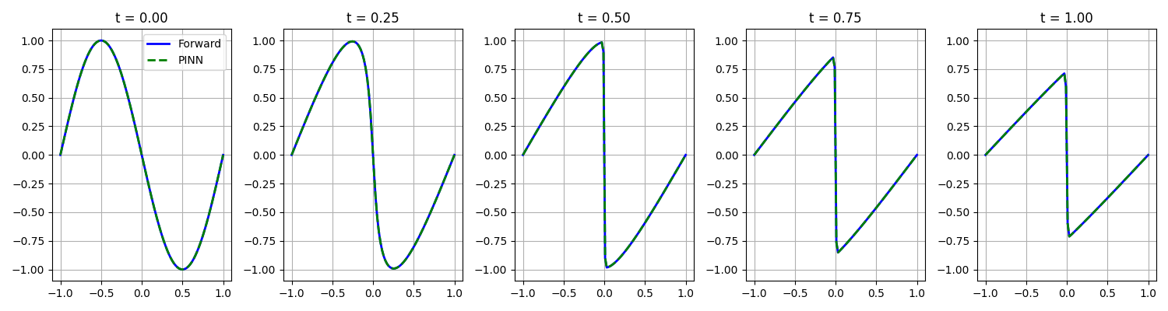
Outputs from the inverse problem program for burger’s equation (lambda 1 and lambda 2 or the boundary conditions and initial conditions have been retrieved using the output of the forward problem program.
Inputs for forward program are ICs and BCs
Input for inverse program is the output of the forward program

Slide 9
Thank you

